Slide 1
Service-Learning Workshop on Participatory Learning and Evaluation
Co-organized by
United Board for Christian Higher Education in Asia (United Board) and Lady Doak College (LDC)
29- 31 March 2023
Serving to Learn, Learning to Serve
DR. RAJESH TANDON
Founder-President, PRIA
UNESCO Co-chair in Community Based Research and Social Responsibility in Higher Education

Slide 2
National Education Policy (NEP) 2020 Mandates
Flexible
Curricula,
Multi modal
Local
Knowledge
Global
Citizenship
Engaged Learning,
Life- long
and
Life- wide
Research for
Local Solutions
to Local
Challenges
To read the Policy, click on the image

Slide 3
Quality Mandates for HEIs in India
Induction Program for Students — Deeksharambh
Adoption of ICT-based Learning Tools for Effective Teaching-learning Process
Social and Industry Connect: University social responsibility
Learning Outcome-based Curriculum Framework (LOCF)
Imparting Life Skills to Students —Jeevan Kaushal
To read the Mandate, click on the image

Slide 4
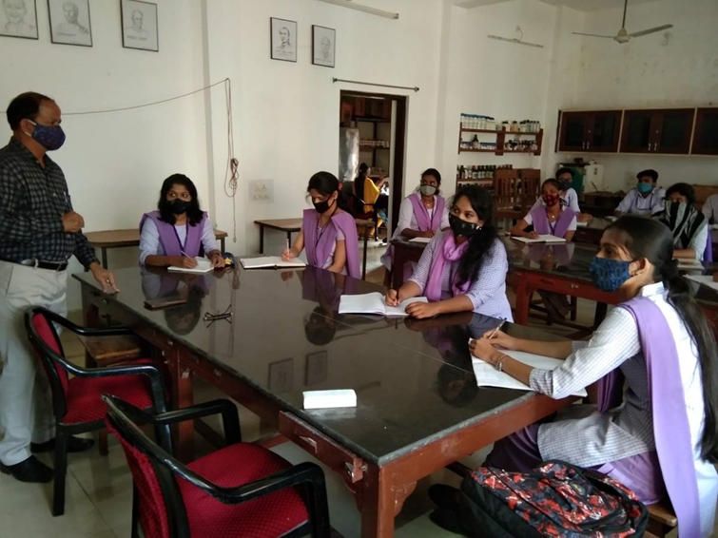
Four Modes of Engagement in UGC Guidelines 2.0
Students
Learning through real world engagement
Understanding local knowledge
Build appreciation of practical challenges
Provide relevant ideas/innovations

Slide 5
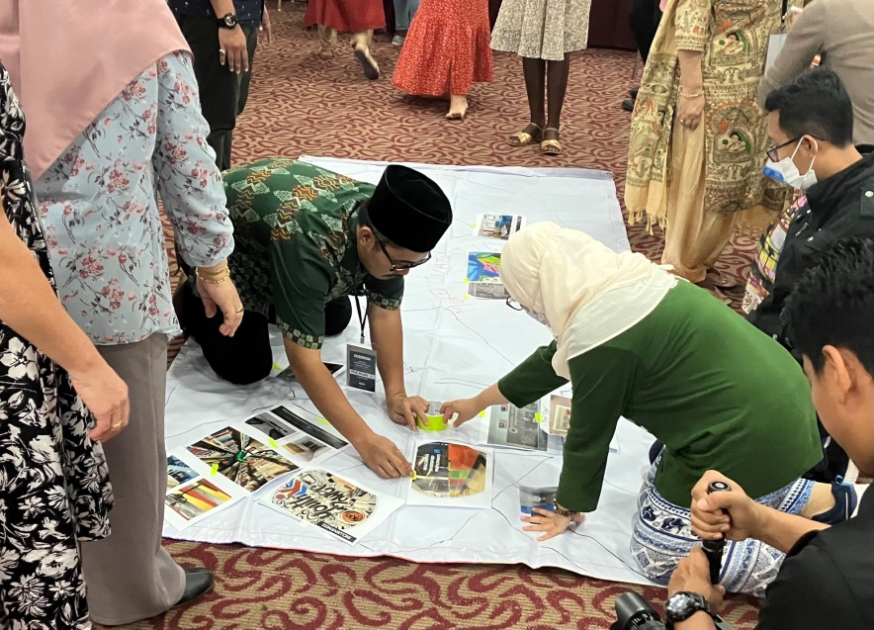
Four Modes of Engagement in UGC Guidelines 2.0
Faculty
Reorientation of teaching to learning
Appreciation of community knowledge
Capacity to listen with open senses
Performance assessment includes engagement

Slide 6
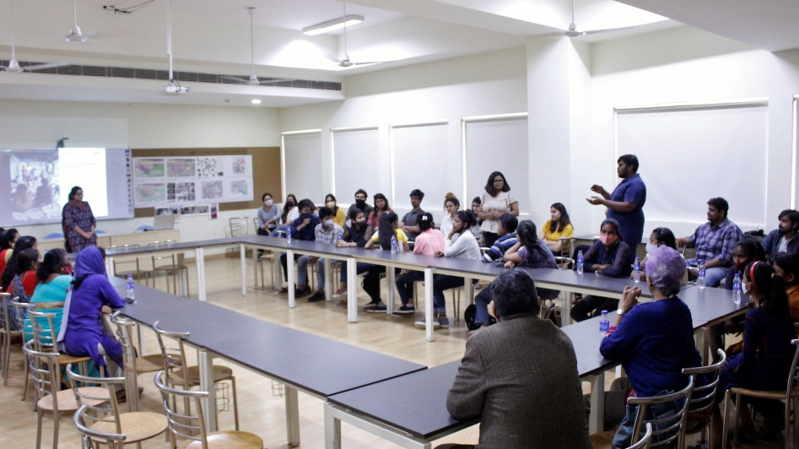
Four Modes of Engagement in UGC Guidelines 2.0
Institution
Alignment to national policy and global best practices
Build capacity of teachers in engagement
Provide human and other resources for long-term partnerships with societal actors
Reform pedagogy & performance assessment of teachers

Slide 7
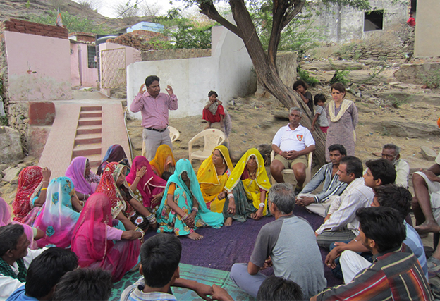
Four Modes of Engagement in UGC Guidelines 2.0
Community
Relationships of mutuality
Trust in long-term partnerships
Demonstrable openness to learn from community knowledge
Support local efforts towards improvements

Slide 8
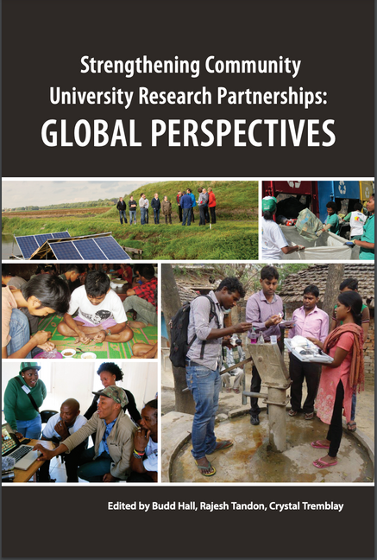
Resources
Click here to access!
Click here to access!
Click here to access!
Click here to access!
Click here to access!
Click here to access!

Slide 9
@pria.india;
@UNESCOchairCBR
@Rtandon_PRIA;
@UNESCOchairCBR;
@PRIA_India
@pria.india,
@UNESCOChairCBRSR
Reach us!
Email: rajesh.tandon@pria.org
Websites: www.pria.org/ www.unescochair-cbrsr.org
Youtube: https://www.youtube.com/user/PRIAIndia / https://www.youtube.com/channel/UCJpmb7ZyuLtW9jkaYbp6Ztw

